Slide 1
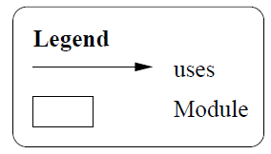
Overall Use Structure
BBD-V (Mobile Devices)
BBD-Ops (Central Managing Service)
BBD-M (Journey Information)

Slide 2
BBD-V Use Structure
Send vehicle speed/location
JSON Encoder/decoder
WKWYL GPS API
Send on-line driver registration
Send on-line vehicle registration
Encode vehicle location/speed
Encode on-line driver registration
Encode on-line vehicle registration

Slide 3
Send Unauthorised access report
BBD-Ops Use Structure
Authorisation logic
Process Journey report
Receive journey report request
Decode vehicle location/speed
Encode Unauthorised access report
Decode journey report request
Unauthorised report access repository
Send journey report
Process Vehicle Location/Speed
Driver Behaviour
Monitor
Police IT RESTful API
Journey Report Repository
Vehicle Location/speed repository
Encode Journey report
Real-time tracking logic
Decode on-line driver registration
Process on-line driver registration
Process on-line vehicle registration
Decode on-line vehicle registration
On-line driver registration repository
On-line vehicle registration repository

Slide 4
BBD-M Use Structure
Send journey report request
Display journey report
Encode journey report request
Receive journey report
Decode journey report received

Slide 5
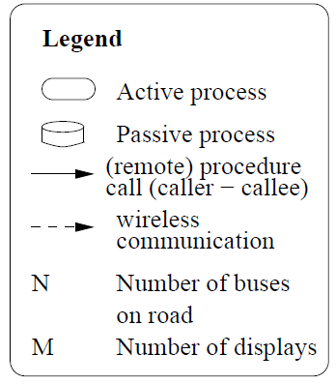
Overall Process Structure
BBD-V (Mobile Devices)
Gathering Journey Information
Registration Requests
N
1
BBD-Ops (Central Managing Service)
Monitoring drivers
Reporting to police
Real-time tracking
Persisting information
Generating reports
Authorising report accesses
1
BBD-M (Journey Information)
Report requests
Display reports
N

Slide 6
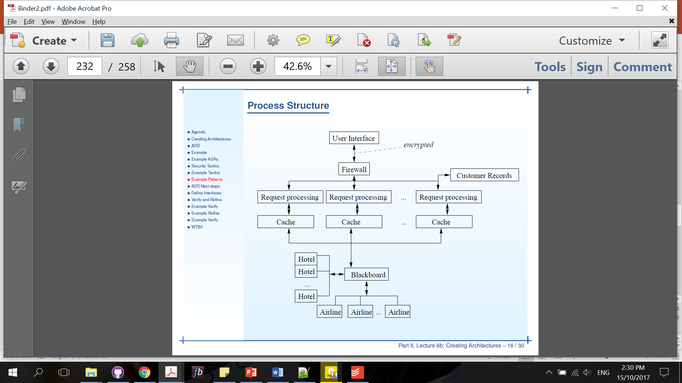
“Process” Structure
UI
1
N
N
N
BBD-V
sending on-line driver registration
sending on-line vehicle registration
Gathering and processing vehicle speed/location
Driver information Cache
Vehicle information Cache
Journey information Cache
Broker (BBD-Ops)
1

Slide 7
“Process” Structure
Broker Interface
1
BBD-Ops
N
on-line driver registration processing
on-line vehicle registration processing
vehicle speed/location processing
Monitor Drivers
Processing report
Authorising report requests
1
1
1
Persist on-line vehicle registration
Persist vehicle speed/location
1
1
Persist on-line driver registration
Reporting to Police process
Persist journey report
Persist unauthorised report requests
Realtime tracking process
Generate unauthorised access report

Slide 8
“Process” Structure
BBD-M
UI
Generating and sending report requests
Processing and displaying reports received
Report requests cache
Journey report received Cache
1
1
Broker (BBD-Ops)

Slide 9
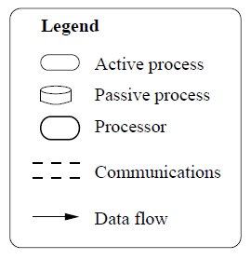
Wireless Network
Local Area Network
Overall deployment structure
BBD-V (Mobile Devices)
Gathering Journey Information
Registration Requests
Send Vehicle location/speed
BBD-Ops (Central Managing Service)
Monitoring drivers
Reporting to police
Real-time tracking
Persisting information
Generating reports
Authorising report accesses
Database Servers
BBD-M (Journey Information)
Report requests
Display reports

Slide 10
Wireless Network
BBD-V Deployment Structure
In each car
Send Vehicle location/speed
BBD-Ops
Send Vehicle registration
Send driver registration

Slide 11
Wireless Network
Host
Local Area Network
BBD-Ops Deployment Structure
on-line vehicle registration processing
on-line driver registration processing
On-line driver registration DB
DB Server
vehicle speed/location processing
Driver Monitor
Host
On-line vehicle registration DB
Host
Processing report
Vehicle speed/location DB
DB Server
Host
Authorising report requests
Journey report DB
DB Server
Host
Realtime tracking process
Reporting to Police process
Unauthorised report requests DB
DB Server

Slide 12
Wireless Network
BBD-M Deployment Structure
Each client
Request journey report
BBD-Ops
Processing and displaying reports received

Slide 13
WKWYL GPS API
Send on-line driver registration
Send on-line vehicle registration
“Process” Structure
BBD-Ops
Noot used
Encode on-line driver registration
Encode on-line vehicle registration
Send vehicle speed/location
Process Vehicle Location/Speed
Vehicle Location/speed repository
Driver Information
Driver Behaviour Monitor

Slide 14
Layered structure
Presentation
Application
Database
BBD-OpS
BBD-OpS
BBD-OpS

Slide 15
“Process” Structure
BBD-M

Slide 16
Send vehicle Location/speed
Process on-line registration
Encode/decode vehicle location/speed
Process vehicle location/speed
Estimator
Send on-line registration
Vehicle location/speed repository
Process vehicle Location/speed
Real time tracking
GPS module
Broker
WKWYL API
Journey Information Repository
Reporting to Police
Reporting to NZTA
Driver Information
Operations
History
Process report
Generate report
Operations

